Slide 1
Information system theory and practice
By Fatima Ejaz Barri

Slide 2
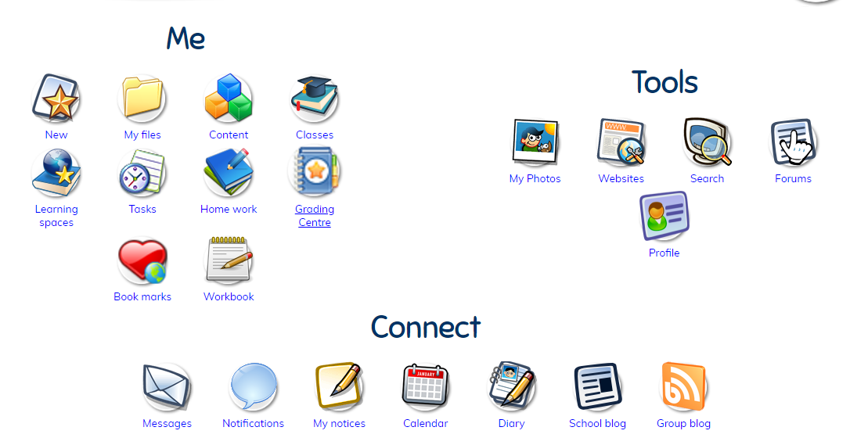
Howard college portal vs gems portal
Gems portal is a very great portal as many students from the UK and internationally use it. The portal has many features to support students in studying and also has many other activities like mini games. The teachers and students interact with each other when needed. The teachers, heads and principle can upload documents/ videos or any form of resources anytime without any interruption.
GEMS portal also allows to give feedbacks to the IT department or the teacher for any kind of fault or uncertainty. Students can also make notes for better understanding of their lessons.

Slide 3
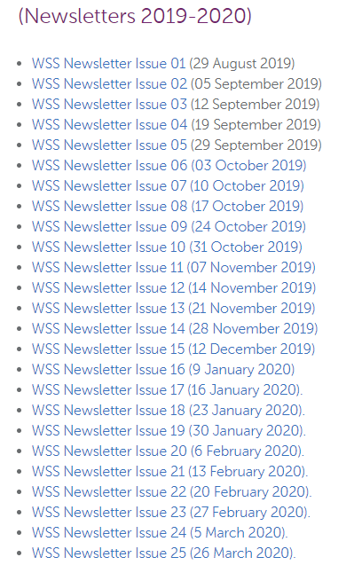
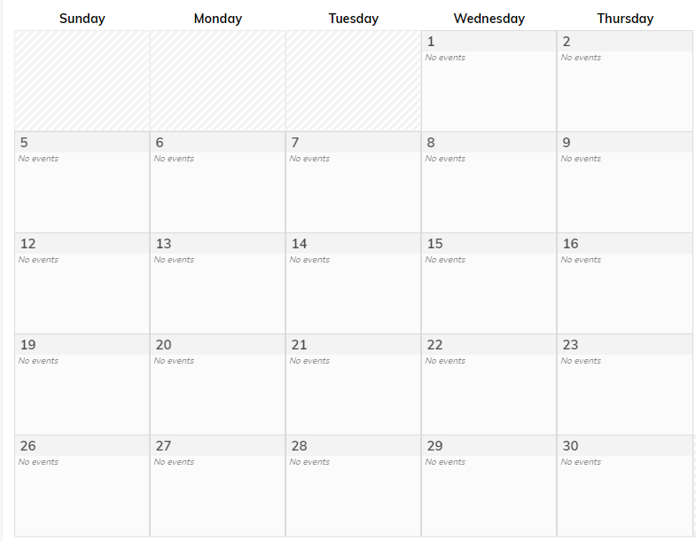
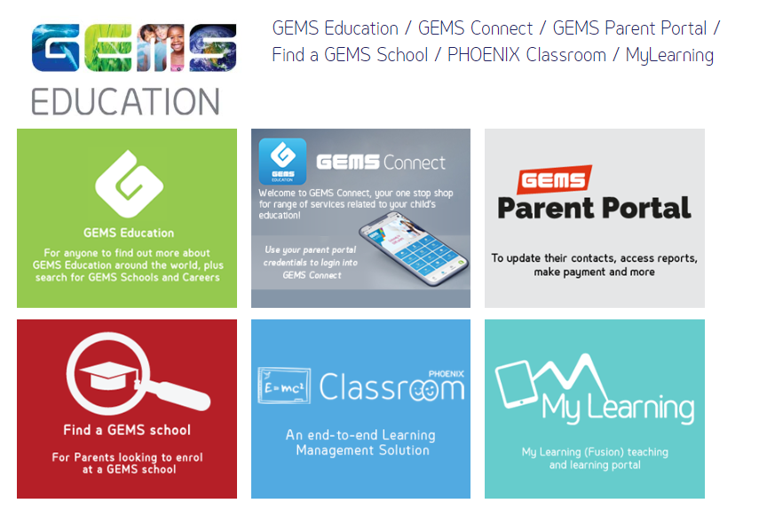
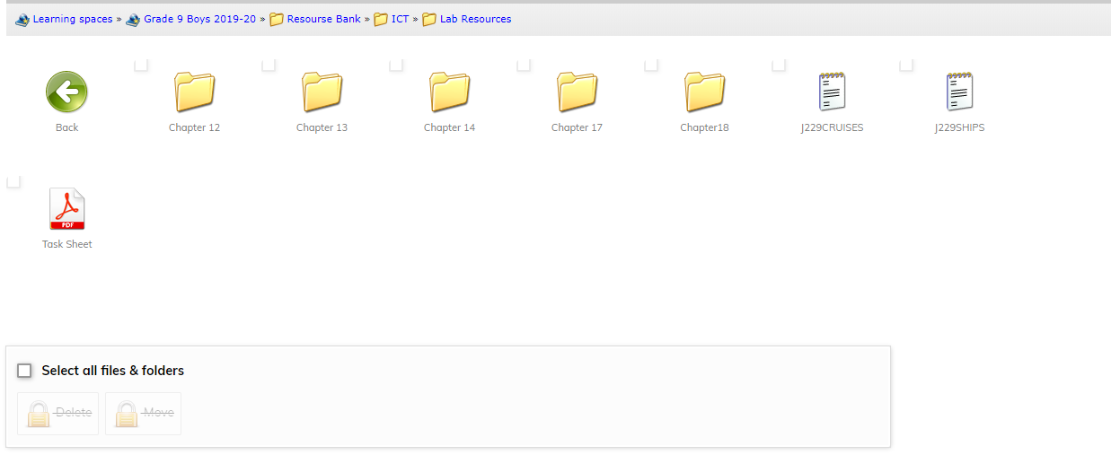
GEMS Portal
GEMS Portal also has various other features on there portal menu i.e. mobile connect, online classroom, parents portal etc..
These features are very useful for any kind of educational organisation.
Unlike Howard Portal, this portal has various features improving students’, parents’ and teachers’ experience in interacting with each other. GEMS portal also allows live chats, video uploading, learning resources, viewing newsletters, event calendar, participation in surveys and quizzes by the teachers, heads and the principle.

Slide 4
The current system shown in the scenario is not effective since it lags, doesn’t respond and the students are unable to join certain quizzes. In addition, the students are not trained and that’s why they can’t operate the current system very effectively. The college can provide guidelines to the students to operate the portal and access any type of information.
A portal like GEMS portal will be good enough and it matches all the requirements which Howard college needs for a effortless system which is easier to use and is useful in any kind of educational activities. Information system can learn from these portals to upgrade their services and acquire customer satisfaction.

Slide 5
ACCONTING INFORMATION SYSTEM (AIS)
An accounting information system is a way of tracking all accounting activity in a business.
There are 6 elements:-
People
Procedures and instruction
Data
Hardware
Software
Internal control
The system users are people like accountants and business analysts.
An AIS provides different departments with the same information. For example, when sales are made:
sales people enter people’s orders in the system
accounting invoices customer
Warehouses assemble the orders
Shipping delivers the orders

